Slide 1
Object Oriented Programming
Computer Science Program
By: Biruk M.

Slide 2
Chapter seven
Exception Handling

Slide 3
Introduction
An Error "indicates serious problems that a reasonable application should not try to catch."
An Exception "indicates conditions that a reasonable application might want to catch.
An exception is an indication of a problem that occurs during a program’s execution.
The name “exception” implies that the problem occurs infrequently—if the “rule” is that a statement normally executes correctly, then the “exception to the rule” is that a problem occurs.
Exception handling enables you to create
applications that can resolve (or handle) exceptions.
In many cases, handling an exception
allows a program to continue executing as if no problem had been encountered. A more severe problem could prevent a program from continuing normal execution, instead requiring it to notify the user of the problem before terminating in a controlled manner.

Slide 4
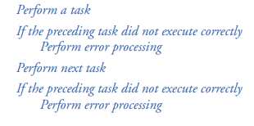
Basic idea:
Helps to write a robust and fault-tolerant programs
.

Slide 5
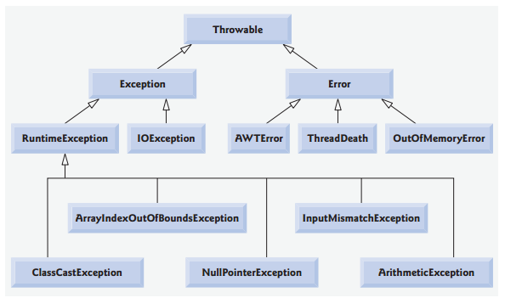
Exception Hierarchy
The Java exception hierarchy contains hundreds of classes.

Slide 6
Cont…
java.lang.Object
java.lang.Throwable
ava.lang.Exception
java.lang.ClassNotFoundException
java.io.IOException
java.io.FileNotFoundException
java.lang.RuntimeException
java.lang.NullPointerException
ava.lang.IndexOutOfBoundsException
java.lang.ArrayIndexOutOfBoundsException
java.lang.Error
java.lang.VirtualMachineError
java.lang.OutOfMemoryError

Slide 7
Types of Exception
There are two types of exceptions:
checked exceptions
are checked at compile-time, It means
if a method is throwing a checked exception then it should handle the exception using try-catch block or it should declare the exception using throws keyword, otherwise the program will give a compilation error.
Eg: SQLException,IOException,ClassNotFoundException
unchecked exceptions-(sub class of RuntimeException class).
are checked at runtime,It means
if your program is throwing an unchecked exception and even if you didn’t handle/declare that exception, the program won’t give a compilation error.
Most of the times these exception occurs due to the bad data provided by user during the user-program interaction.
It is up to the programmer to judge the conditions in advance, that can cause such exceptions and handle them appropriately.
Eg: ArithmeticException, NullPointerException,ArrayIndexOutOfBoundsException

Slide 8
Examples:
public static void main(String args[]){
try{
int arr[] ={1,2,3,4,5}; System.out.println(arr[10]); }
catch(ArrayIndexOutOfBoundsException e){
System.out.println("The specified index does not exist " + "in array. Please correct the error.");
}
}
class Example {
public static void main(String args[]) {
int arr[] ={1,2,3,4,5}; System.out.println(arr[10]);
}}
What type of exception?

Slide 9
How Exceptions are handled?
Using Try-Catch block
try{
statements
resource-acquisition statements
} // end try
catch ( AKindOfException exception1 )
{exception-handling statements
}
catch ( AnotherKindOfException exception2 )
{exception-handling statements
}
finally
{
statements
resource-release statements
}

Slide 10
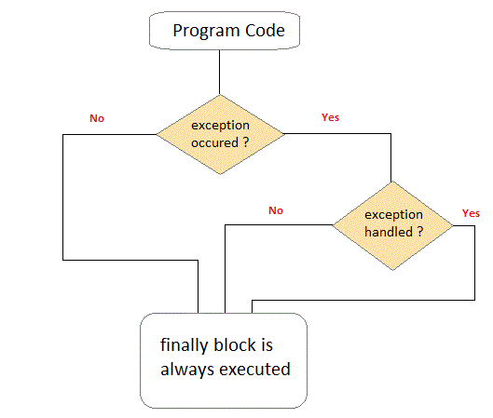
Cont…

Slide 11
Cont…
1. Try
a try block, which encloses the code that might throwan exception
and the code that should not execute if an exception occurs
the remaining code in the try block will be skipped if the exception occurs.
A try block consists of the keyword try followed by a block of code enclosed in curly braces ({})
2. throws clause
specifies the exceptions the method throws. This clause appears after the method’s parameter list and before the method’s body.
It contains a comma-separated list of the exceptions that the method will throw if a problem occurs
Eg-public static void main(String args[]) throws SQLException

Slide 12
Cont…
Throw vs Throws
Throws clause is used to declare an exception and thow keyword is used to throw an exception explicitly.
Checked exception can only be propagated with throws.
Throws is followed by a Class but throw is followed by an instance
Throws is used with the method signature but throw is used inside a method
You cannot throw multiple exceptions but possible to declare multiple exceptions using throws
Without the throws clause in the signature the Java JVM compiler does not know what to do with the exception.
The throws clause tells the compiler that this particular exception would be handled by the calling method.
Eg:
ArithmeticException exp = new ArithmeticException(); throw exp;
Public void fun() throws IOException, ArithmeticException,

Slide 13
Cont…
3. A catch block/ exception handler )
catches /receives and handles an exception.
A catchblock begins with the keyword catch and is followed by a parameter in parentheses (called the exception parameter, )and a block of code enclosed in curly braces.
At least one catchblock must imme-diately follow the try block. Each catchblock specifies in parentheses an exception-parameter that identifies the exception type the handler can process
Eg- catch (SQLException ex ){}

Slide 14
Cont…
4. Finally block
Programs that obtain certain types of resources must return them to the system explicitly,to avoid so-called resource leaks .
In programming languages such as C and C++, the most common kind of resource leak is a memory leak.
Java performs automatic garbage collec-tion of memory no longer used by programs, thus avoiding most memory leaks. However,
other types of resource leaks can occur. For example, files, database connections and net-work connections that are not closed properly might not be available for use in other pro-grams.

Slide 15
Cont…
Actually,Java does not entirely eliminate memory leaks.
Java will not garbage-collect an object until there are no remaining references to it. Thus, if programmers erroneously keep references to unwanted objects, memory leaks can occur.
Always release each resource explicitly and at the earliest possible moment at which it is no longer needed.
This makes resources immediately available to be reused by your program or other pro-grams, thus improving resource utilization..
Because the finally block is guaranteed to execute whether or not an exception occurs in the corresponding try block,
this block is an ideal place to release resources acquired in a try block.
This is also an effective way to eliminate resource leaks. For example, the finally block should close any files opened in the try block.

Slide 16
Cont…
a finallyblock typically contains resource-release code.
Suppose a resource is allocated in a try block. If no exception occurs, the catch blocks are skipped and control proceeds to the finally block, which frees the resource.
Control then proceeds to the first statement after the finallyblock. If an exception does occur in the try block, the program skips the rest of the try block. If the program catches the exception in one of the catchblocks, the program processes the exception, then the finallyblock releases the resource, and control proceeds to the first statement after the finallyblock.

Slide 17
Note:
Java has an automatic garbage collector
Don confuse Finally block with built-in finalize() function?
The java.lang.Object.finalize() is called by the garbage collector on an object when garbage collection determines that there are no more references to the object.
A subclass overrides the finalize method to dispose of system resources or to perform other cleanup.
Finalize is used to perform clean up processing just before object is garbage collected.
try{
Student s1=new Student("IT","Henok",20);
s1.Display();
s1.finalize();
}
catch(Throwable e)
{ e.printStackTrace();}

Slide 18
Example
import java.util.*;
import java.io.*;
public class ExceptionEg {
// demonstrates throwing an exception when a divide-by-zero occurs
public static int quotient( int numerator, int denominator )
{
return numerator / denominator; // possible division by zero
} // end method quotient
public static void main( String args[] )
{
Scanner scanner = new Scanner( System.in ); // scanner for input
boolean continueLoop = true; // determines if more input is needed

Slide 19
Cont…
do
{
try // read two numbers and calculate quotient
{
System.out.print( "Please enter an integer numerator: " );
int numerator = scanner.nextInt();
System.out.print( "Please enter an integer denominator: " );
int denominator = scanner.nextInt();
int result = quotient( numerator, denominator );
System.out.printf( "\nResult: %d / %d = %d\n" , numerator,denominator, result );
continueLoop = false; // input successful; end looping
} // end try

Slide 20
Cont…
catch ( InputMismatchException inputMismatchException )
{
System.err.printf( "\nException: %s\n",inputMismatchException );
scanner.nextLine(); // discard input so user can try again
System.out.println("You must enter integers. Please try again.\n" );
} // end catch
catch ( ArithmeticException arithmeticException )
{System.err.printf( "\nException: %s\n", arithmeticException );
System.out.println("Zero is an invalid denominator. Please try again.\n" );
} // end catch
finally {System.out.println("finished");}
} while ( continueLoop );} }

Slide 21
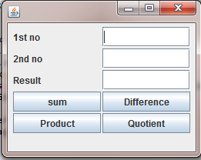
Exercise
1. insert two numbers using JoptionPane and calculate the quotient (use exceptions)
2. Design the GUI below and handle the probable exceptions
3. compare null value to string value, show haw NullPointerException achieved
4. show haw ArrayIndexOutOfBoundException Using example

Slide 22
Thank you
Questions?

